Slide 1
Normalization: 2NF Assignment
Nathaniel Clayton

Slide 2
2NF Assignment
Learning objectives:
Upon successful completion of this assignment, students will be able to:
Apply 1NF and 2NF to unnormnalized tables.
Understand normalization and ER modeling are used concurrently to produce a good database design.
Submission:
Please work on this PPT file, and upload your completed work to Assignment 1NF Normalization Assignment
Copy and paste your ER diagram you drew using either draw.io or MS Visio to this file.
Please do not submit your ER diagram as jpg file or XIP file. It will NOT be graded.
Due: October 30, 2018, 11:00 am Late submissions are not accepted.

Slide 5

MOVIE-LANGUAGE
A movie company has provided a set of sample data they want to store in relational databases.
MOVIE_ID | MOVIE_TITLE | LANG_CODE | LANGUAGE
101 | Kung Fu Panda | en es fr zh | English Spanish French Chinese
102 | My Little Pony | en es | English Spanish
103 | Frozen | en de | English German
Business Rules
Each movie is available in at least one language, but can be available in many languages.
A language may not be used in any movies, but can be used in many movies.
Please determine a minimum number of cardinality and a maximum number of cardinality, based on the business rules.

Slide 6
MOVIE - LANGUAGE
Explain why the table is in 1NF or not (2 points):
It is not 1NF because the lang_code and language attributes are multivalued.

Slide 7
MOVIE - LANGUAGE
State each step to make it 1NF (2 points):
Create a new table called Language
Relate Movie to Language (One to Many)
Give Language table Foreign Key of MOVIE’s Primary Key

Slide 8
MOVIE - LANGUAGE
Relational tables in 1NF (3 points)
MOVIE(movieID, title)
Primary Key: movieID
LANGUAGE(movieID, langCode, language)
Primary Key: movieID, langCode
Foreign Key: movieID references MOVIE

Slide 9
MOVIE - LANGUAGE
Explain why the tables in 2NF or not (3 points):
It is not 2NF because to be in 2NF, it has to also be in 1NF and it is not 1NF because it has multivalued attributes.

Slide 10
MOVIE - LANGUAGE
State each step to make it 2NF (2 points):
1. Put it in 1NF form
2. make non-key attributes fully functional dependent on the primary key
3. Remove movieID foreign key from Language table
4. Create new table called Movie_Lang with PK as Language’s and Movie’s Primary Key.

Slide 11
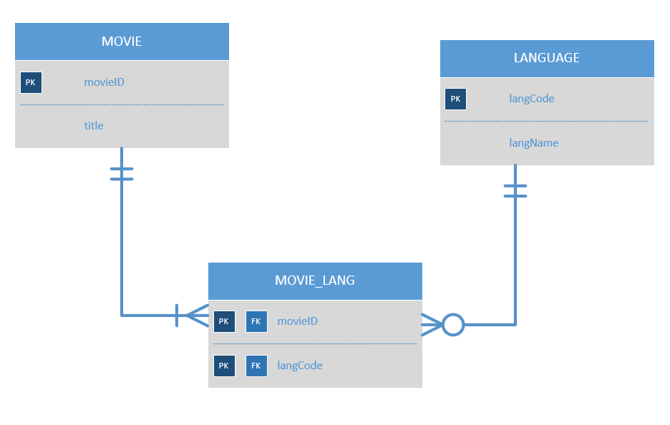
MOVIE – LANGUAGE
Draw an ER Diagram corresponding to relational tables in 2NF (4 points):

Slide 12
MOVIE – LANGUAGE
Relational tables in 2NF (4 points):
MOVIE(movieID, title)
Primary Key: movieID
LANGUAGE(langCode, langName)
Primary Key: langCode
MOVIE_LANGUAGE(langCode, movieID)
Primary Key: langCode, movieID
Foreign Key: langCode references LANGUAGE
movieID references MOVIE

Slide 13



Football_Player – Team
A football player agency has provided a set of sample data about football players and teams they have played for.
PLAYER_ID | PLAYER_FNAME | PLAYER_LNAME | TEAM_CODE | TEAM_NAME
1 | Tom | Brady | NE | New England Patriots
2 | James | Harrison | NE | New England Patriots
3 | Mark | Sanchez | PHI | Philadelphia Eagles
3 | Mark | Sanchez | DAL | Dallas Cowboys
5 | Richard | Sherman | SEA | Seattle Seahawks
6 | Eddie | Lacy | GB | Green Bay Packers
6 | Eddie | Lacy | SEA | Seattle Seahawks
Business Rules:
A football player has played for at least one team, or many teams.
A team has had at least one player, and can have had many players.
Please determine a minimum number of cardinality and a maximum number of cardinality, based on the business rules.

Slide 14
Player - TEAM
Explain why the table is in 1NF or not (2 points):
It is not 1NF because a player could play for multiple teams which would create repeating attributes as the table is currently set up.

Slide 15
Player - TEAM
State each step to make it 1NF (2 points):
Create Table called Player with playerID, fname, lname attribute
and a foreign key of teamCode
Create table called Team with teamCode, teamName attributes

Slide 16
Player - TEAM
Relational tables in 1NF (3 points):
Keep in mind that you should correctly mark which one is a primary key.
TEAM(teamCode, teamName)
Primary Key: teamCode
PLAYER(playerID, teamCode, fname, lname)
Primary Key: playerID, teamCode
Foreign Key: teamCode references TEAM

Slide 17
Player - TEAM
Explain why the tables in 2NF or not (3 points):
Please make sure that you provide an explanation for EACH TABLE.
You should be able to define and present PARTIAL DEPENDENCY.
It is not in 2NF because the fname and lname attribute of the Player table are not dependent on the whole composite primary key, it is dependent on playerID but not teamCode. The Team table is fine as is.

Slide 18
Player - TEAM
State each step to make it 2NF (2 points):
Create Player_Team table with playerID and teamCode as Primary Key
Reference Player_Team to PLAYER table using playerID
Reference Player_Team to TEAM table using teamCode
Relate Player table to Player_Team (one to many)
Relate Team table to Player_Team (one to many)

Slide 19
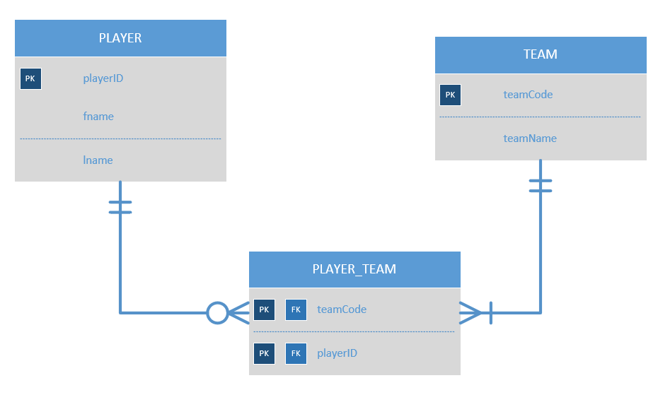
Player - TEAM
Draw an ER Diagram corresponding to relational tables in 2NF (4 points):

Slide 20
Player - TEAM
Relational tables in 2NF (4 points):
When you draw an ER diagram, please determine a minimum and maximum number of cardinality, based on business rules.
PLAYER(playerID, fname, lname)
Primary Key: playerIDID
TEAM(teamCode, teamName)
Primary Key: teamCode
PLAYER_TEAM(teamCode, playerID)
Primary Key: teamCode, playerID
Foreign Key: teamCode references TEAM
playerID references PLAYER

